Slide 1
In this study, we are asking you to use a tool called Cognitive-Affective Map to depict your thoughts, feelings and assessments regarding your attitude towards an emerging technology, which you will be informed about shortly. The following instructions will help you to understand how to use this tool.

Slide 2
Example farmers’ market:
Julia regularly shops at the farmers’ market and has many different thoughts and impressions about farmers’ markets versus alternative grocery stores.
Using the mind-mapping tool, Julia is able to draw the impressions and thoughts she has about “shopping at the farmers’ market”. She is also able to evaluate and link her written impressions with each other.

Slide 3


To add ideas, she simply clicks on the white background of the C.A.M.E.L. software
A yellow box will appear.
By clicking again on a free space on the white background, Julia can add more concepts.

Slide 4
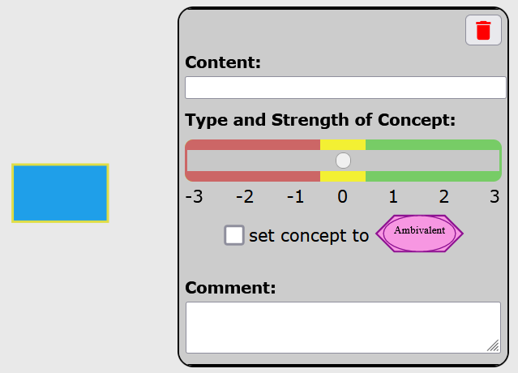
To change ideas, Julia double clicks on the drawn concept.
A dialogue window pops up.
Here you can change the content, type and strength of the concept and add a comment.

Slide 5
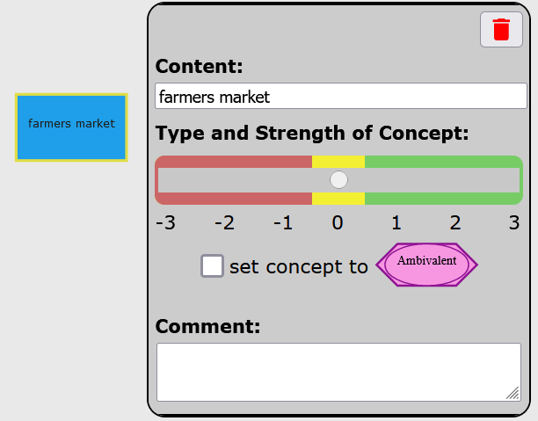
Julia changed the content of the concept to “farmers’ market” by simply writing within the content field:
Julia can now include other concepts that are important to her decision to shop at the farmers’ market.

Slide 6
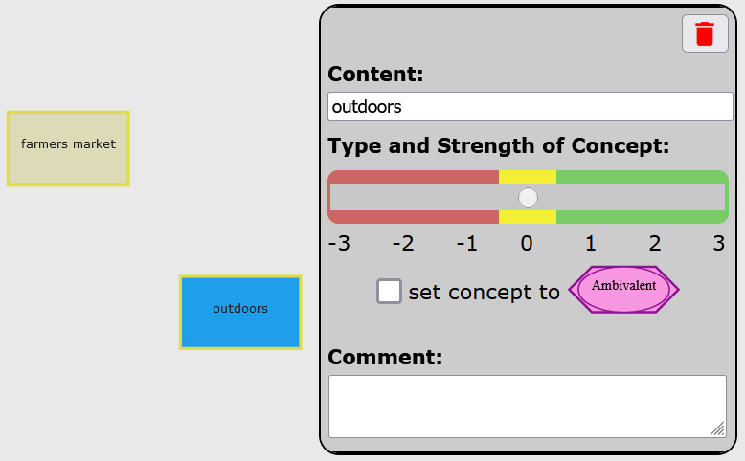
Next, she notes that the farmers’ market takes place outdoors

Slide 7
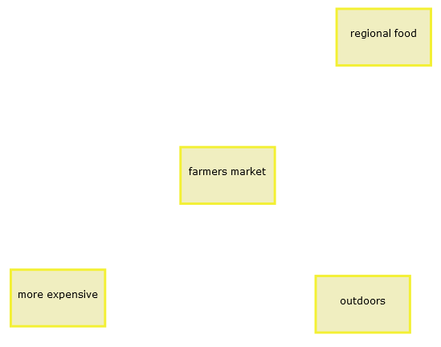
Julia adds two more concepts.

Slide 8

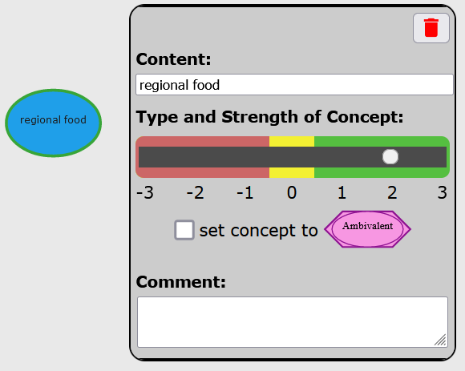
Yellow squares represent concepts that are neutral.
However, concepts can be positive, negative, neutral, or ambivalent.
Double-click a concept and using the slider to adjust the emotion towards the concept

Slide 9

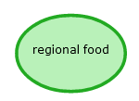
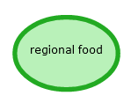
Julia feels positive about “regional food”.
Positive concepts are represented by green ovals.
The concept turns green when the slide bar is moved further to the right.
Slightly positive
Intermediate positive
Very positive
The slide bar offers three strengths for positive evaluation.
The thicker the border, the more positive the concept weighs!

Slide 10
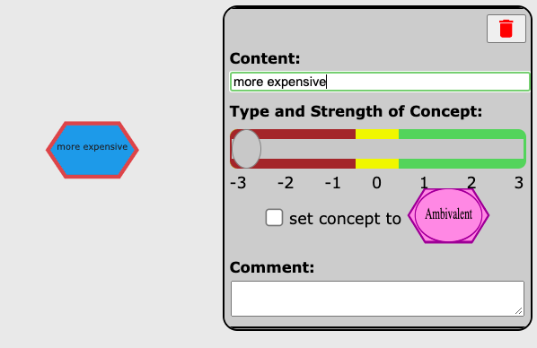
Julia does not like that the food is more expensive than at the supermarket.
Negative concepts are represented in the shape of a red hexagon. For negative concepts, the same logic applies as for the positive concepts.
Julia chooses “-3” to indicate that this point is very negative for her.

Slide 11



Julia feels negative about “more expensive”.
Negative concepts are represented by red hexagons.
The concept turns more reddish when the slide bar is moved further to the left.
Slightly negative
Intermediate negative
Very negative
The slide bar offers three strengths for negative evaluation.
The thicker the border, the more negative the concept weighs!

Slide 12
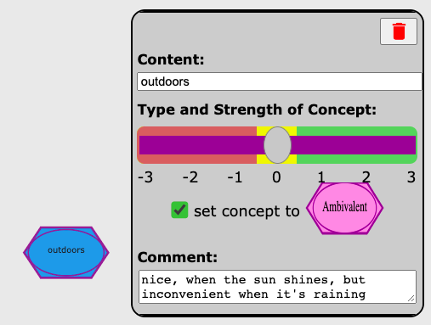
Julia is ambivalent about the fact that the farmers’ market is “outdoors”. Ambivalent indicates that Julia has mixed, meaning both positive and negative, feelings about it.
To indicate ambivalence, Julia clicks the box under the slider. Ambivalences are shown as superimposed violet ovals and hexagons.

Slide 13


Below you can see all colors, shapes and their meanings.
The thicker the border (for green and red), the more intense the feeling.
neutral
ambivalent
negative
positive

Slide 14
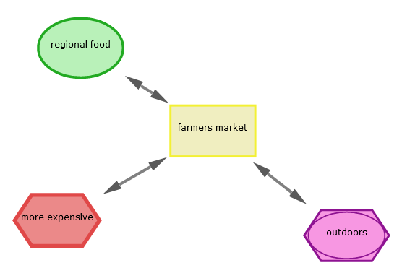
Next, Julia wants to relate concepts with each other.

Slide 15
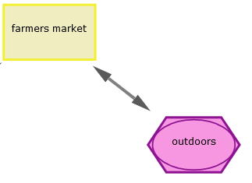
To connect two concepts, Julia must single-click on both.
outdoors
Single-clicking on the second concept will lead to a double arrow appearing between the two concepts.
Single-clicking a concept will highlight the border in blue.

Slide 16
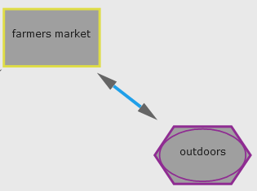
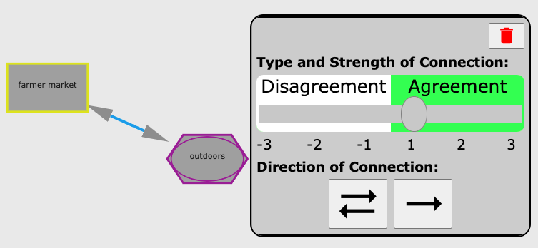
Let´s look at the different connector options.
If Julia double-clicks the link, the menu appears.
The default setting of a link is a two-way solid arrow.
A solid arrow indicates that two concepts agree or support one another.
A dashed arrow indicates that two concepts conflict with one another.
Julia can indicate agreement or disagreement using the slider.

Slide 17
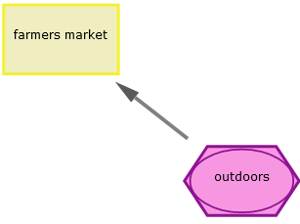
Julia can also change the arrow to indicate that the influence is one-sided.
To change the direction of the arrow, she needs to click up to two times on the single-arrow button.
For Julia, being “outdoors” has a one-sided supportive influence on going “shopping at the farmers’ market”.

Slide 18
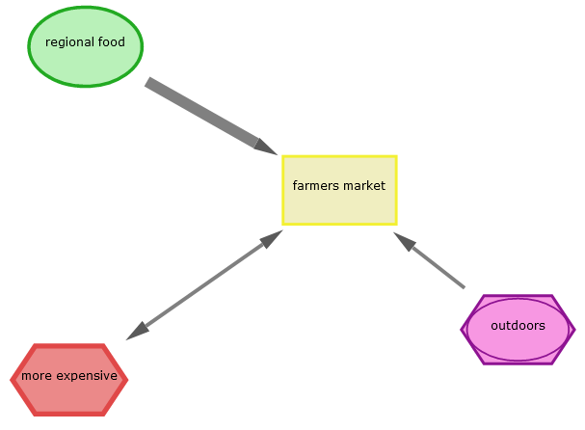
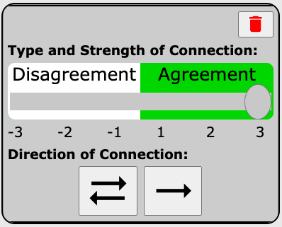
Based on the thickness of the lines, we can see that for Julia, the influence of “regional” food on the decision to go to the farmers’ market is stronger than the influence of “outdoors”
She moves the slider to the right

Slide 19
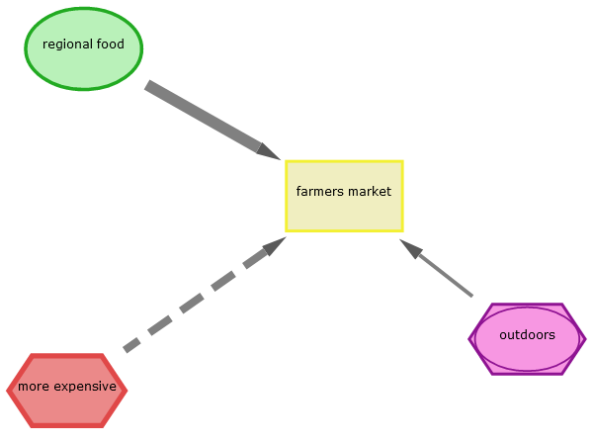
In comparison to the "regional" factor, “more expensive" food conflicts with “shopping at the farmers’ market“ and is represented by a dashed arrow.
This means: The more expensive the food, the less likely Julia is to go shopping at the farmers’ market.

Slide 20
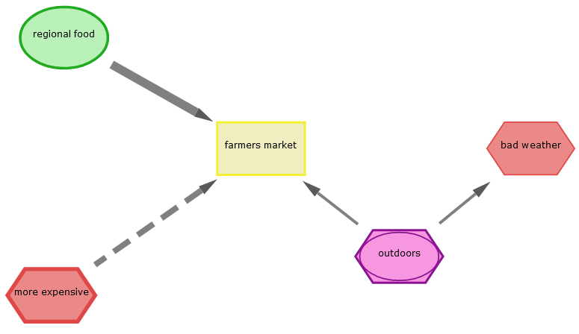
Note that the type of connection is independent of the type of concept. A negative concept can also be connected via a solid arrow: This means, as the market takes place outdoors, there is the risk of being exposed to bad weather.

Slide 21
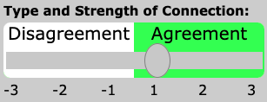

Here you can see again the connector types:
Ideas conflict with each other
Ideas agree with each other
Examples:
If the weather is bad, I don't go to the farmers’ market
If “bad weather” then no “farmers’ market"
Examples:
When the weather is good I go to the farmers’ market
- If “good weather” then “farmers’ market"
Creates a two-sided arrow for concepts influencing each other
Creates a one-sided arrow &
changes the arrow’s direction

Slide 22
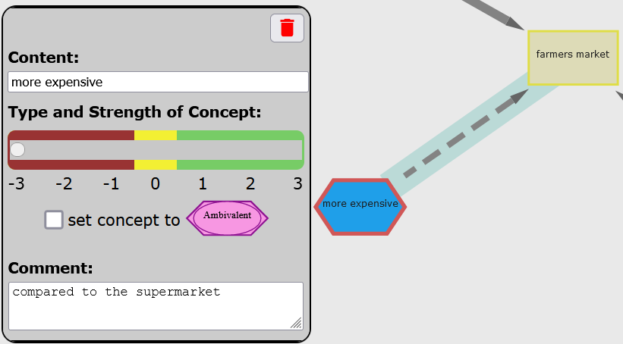
As Julia can only type up to three words into the ‘Content’ textbox, she can also comment on each concept in her map by
double-clicking it and then typing into the ‘Comment’ textbox.
Julia types the following comment in the text box.

Slide 23
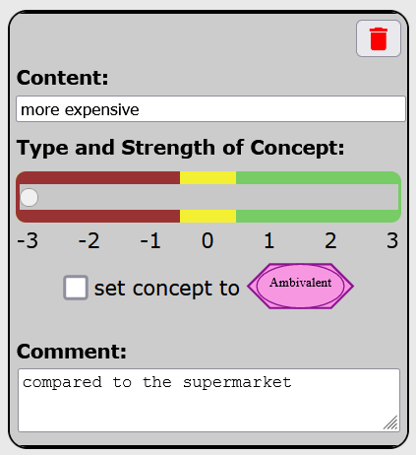
You can delete concepts and connectors by double-clicking them and clicking on the red trashcan-symbol.
On the next page, you can see Julia´s final map!

Slide 24
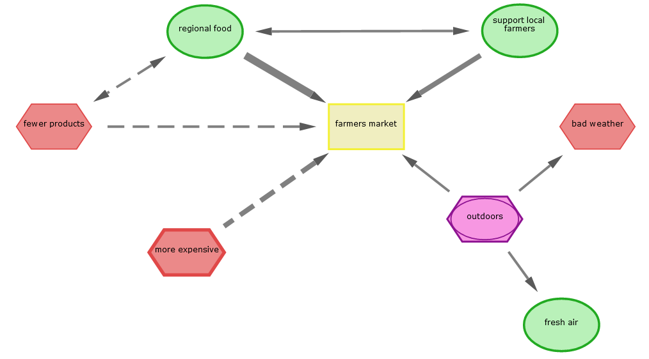

Slide 25
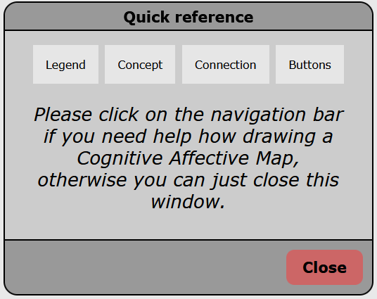
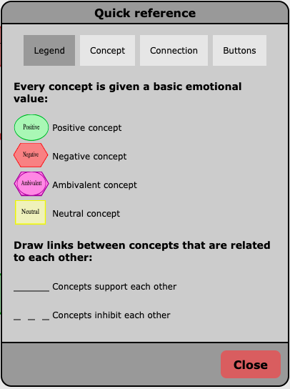
If Julia needs help to draw her Cognitive-Affective-Map, she can click on the green question mark symbol.
A menu with quick references will appear, in which she can navigate by clicking on the topics she needs help for.

Slide 26

When Julia has finished her Cognitive-Affective-Map she needs to click onto the little disk symbol to save it.
Note: She can only save her Map when she has connected all concepts.
Additionally, she needs to draw at least 24 concepts to save her Map.

